Slide 1



"Uncovering patterns through clustering using unsupervised learning"
IPBA Batch 13 – Group A
John Reynolds | Anuj Tiwari | Ashish Mahajan| Suraj Gutte
Trompess Francis | Simrat Kaur | Rahila Rajvada | Priya Roy

Slide 2
INDEX
Business Problem and Objective
Data Overview
Data Preparation and Pre-processing
Exploratory Data Analysis
Model Development - Clustering
Businesss Recommendations

Slide 3
PROBLEM STATEMENT
Segment the retail stores into clusters using unsupervised learning to analyze the performance of its stores
OBJECTIVE
Identify the right number of distinct clusters
Maximize the homogeneity within each cluster
Balance between model complexity and interpretability
Optimize for a specific business goal

Slide 4
Data Overview
The data is of “Adidas” products for 6 retailers across cities of US with information on geography, channel type & sales variables over 2 years.
TIME FRAME
2 years data from 1/1/2020 to 31/12/2021
FEATURES
Categorical | Numerical
Retailer name | Price per unit
Retailer ID | Units Sold
Invoice Date | Sales value
Region | Operating profit
State | Operating margin
Sales Method
City
DATASET SNAPSHOT
Retailer | Retailer ID | Invoice Date | Region | State | City | Product | Price per Unit | Units Sold | Total Sales | Operating Profit | Operating Margin | Sales Method
Foot Locker | 11857 | 01-01-2020 | North | New York | New York | Men's Street Footwear | $50.00 | 1,200 | $6,0 | $3,00,000 | 50% | In-store
Data Set Source - https://data.world/stellabigail/adidas-us-sales-datasets

Slide 5
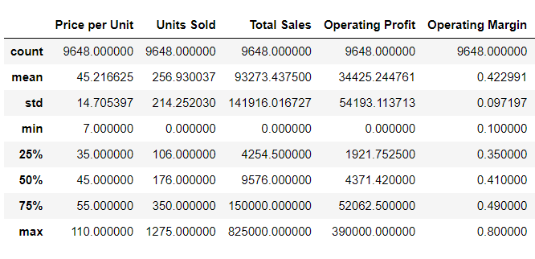
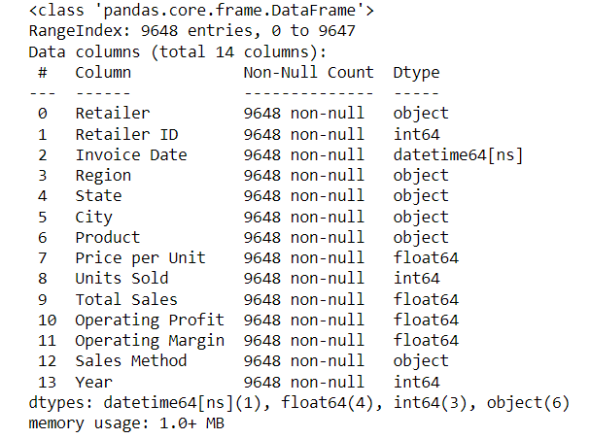
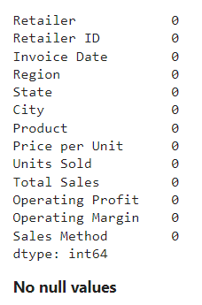
Data Preparation and Pre-processing
Checked the data set for number formatting, missing values, outliers, feature selection
NUMERICAL FEATURES INSIGHTS
DATA DESCRIPTION
MISSING VALUE

Slide 6
Data Observations
COMPLETENESS
The data was clean with no missing values observed
OUTLIERS
Observed outliers but not treated them as these may become part of a cluster subsequently
FEATURE SELECTION
Considered all numerical features. Removed “retailer id” as it’s not a relevant feature for clustering
NORMALIZATION
Used standard scaler to ensure all features are on the same scale

Slide 7
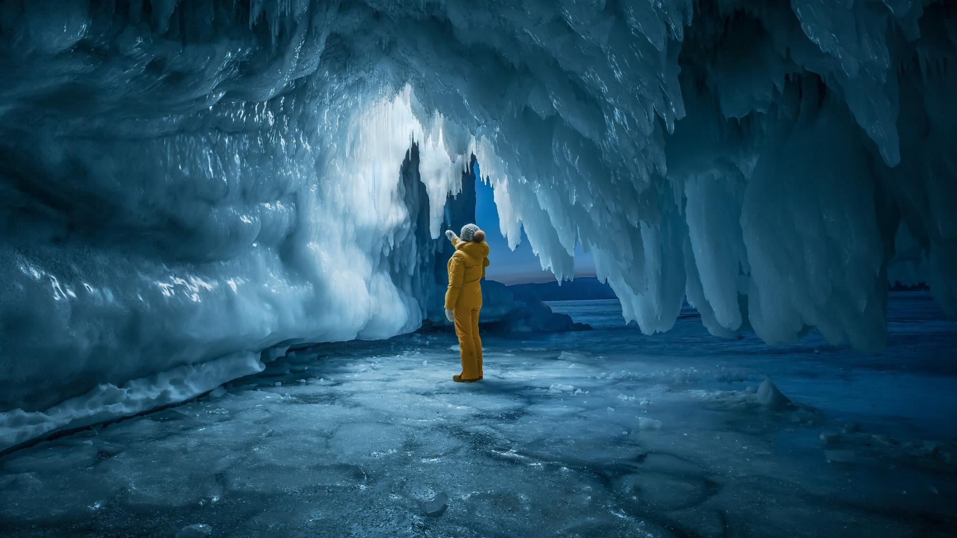
Exploratory Data Analysis

Slide 8
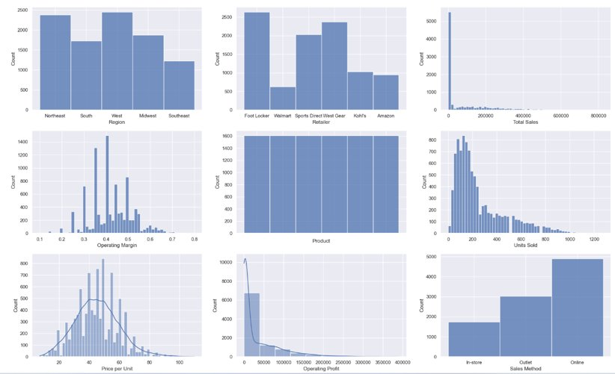


Exploratory Data Analysis - Univariate
Key Highlights
Footlocker is the most frequent occurring retailer in the dataset​
​Total Sales, Operating profit, and Units Sold are interrelated and are right skewed​
​'Price Per unit' is normally distributed.
'Operating Margin' almost takes the shape of a bell​
Online sales are the highest​
All products are almost equally distributed​
North-east and West contribute to the most observed regions throughout the dataset​
© 2023 Jigsaw Academy Education Pvt Ltd.

Slide 9
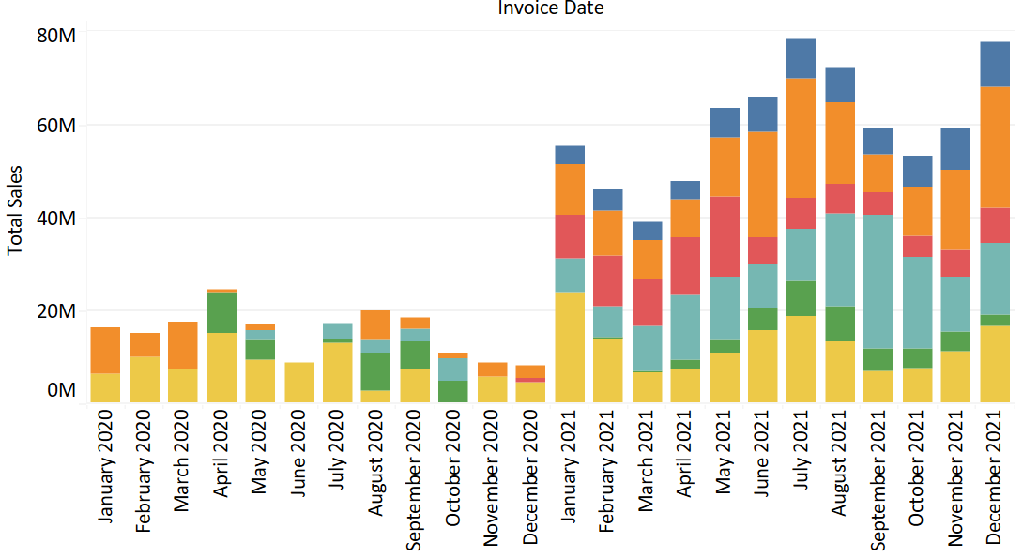
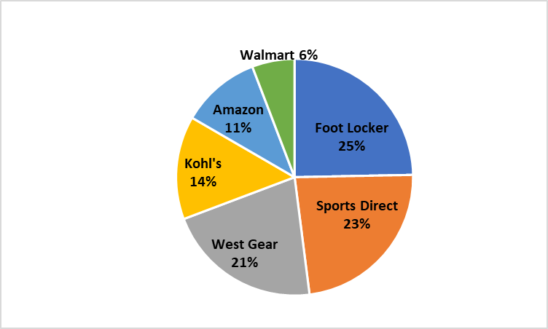
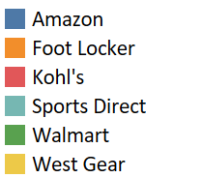
Bivariate Analysis (TBA)
Exploratory Data Analysis – Bivariate ​
In first couple of month data available for only West gear & Footlocker. Most retailers data available consistently from Jan2021 onwards
Overall sales grew by 4X from 2020 to 2021, with Amazon being the new entrant in the market in 2021
West Gear, Footlocker and Sports Direct occupied ~69% of the total market share in 2021
Sales Trend (last 2 years)
Y-O-Y Growth in Sales
Market share - 2021

Slide 10
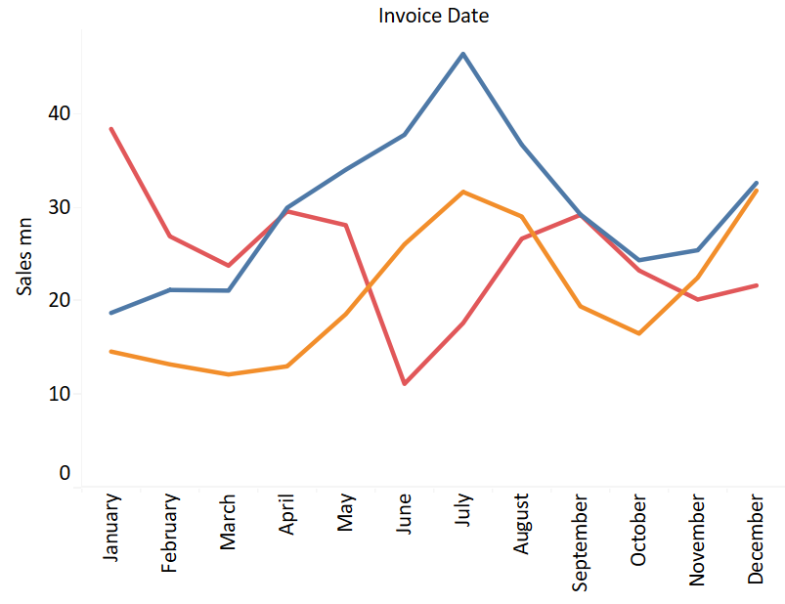
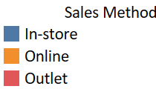
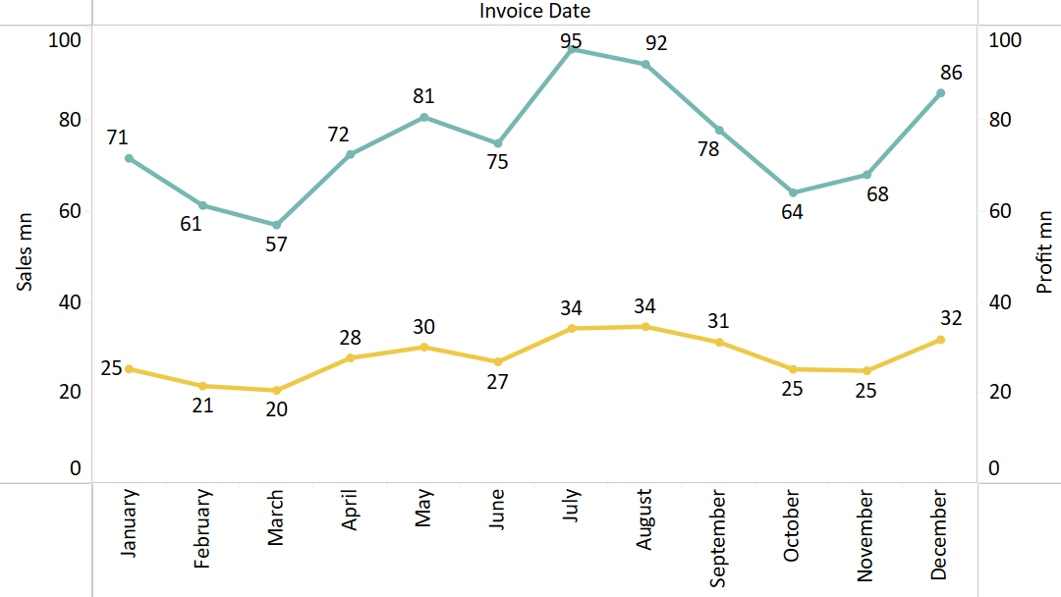

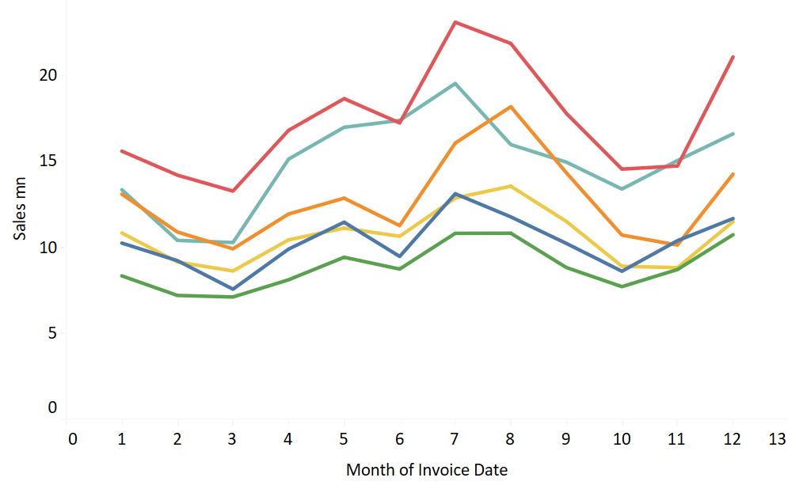
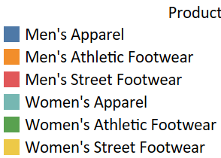
Exploratory Data Analysis – Bivariate ​
UNDERSTANDING SEASONALITY
July & August are the biggest months in sales & profit value followed by Dec & May
Similar trend observed in both Sales & Profit
All product’s reflected similar seasonality
Different trend in “Outlet sales” with lower sales in June & highest

Slide 11
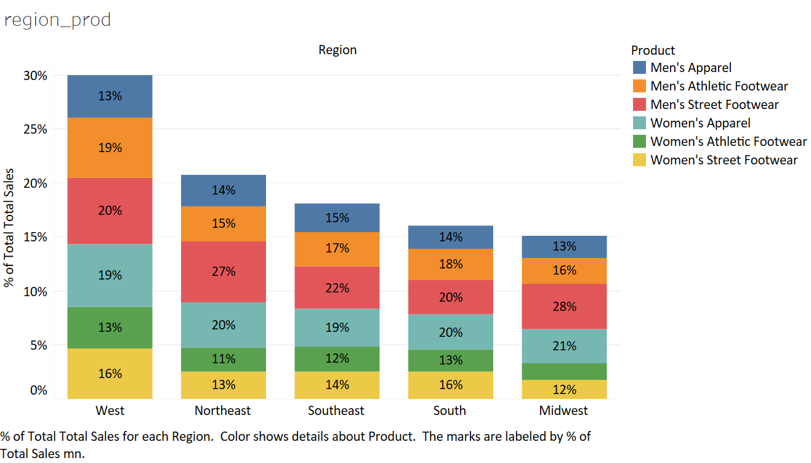
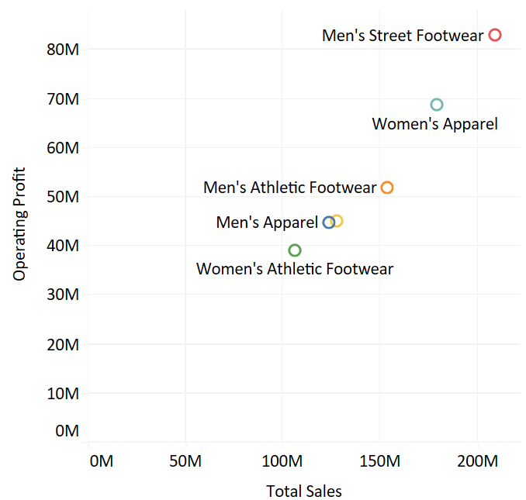
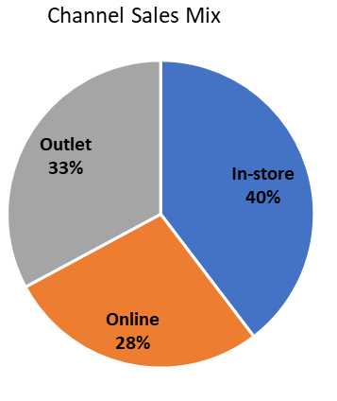
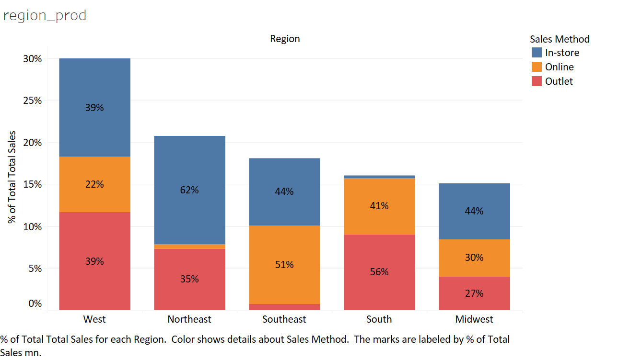
Bivariate Analysis (TBA)
Exploratory Data Analysis - Bivariate
UNDERSTANDING GEOGRAPHY BEHAVIOUR
Men’s street footwear & women’s apparel are key sales & profit drivers
Channel mix is good with highest contr. “In-store”
Product mix similar across geographies
North east - higher In-store contr.
South east - higher mix of Online
South - Outlet contr. higher

Slide 12
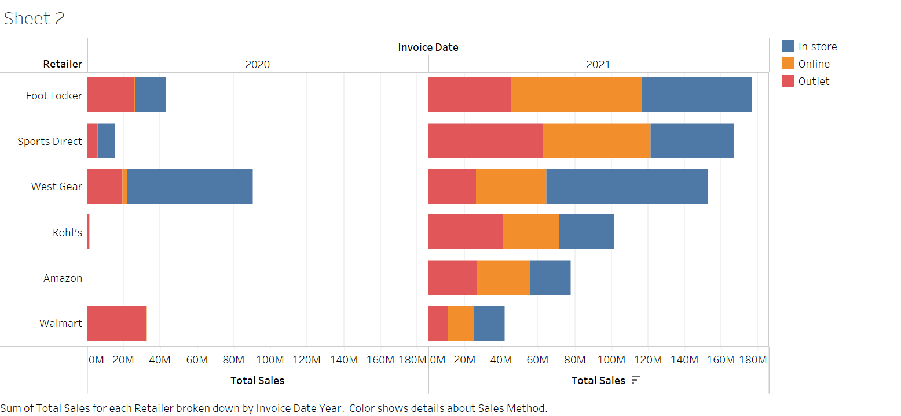
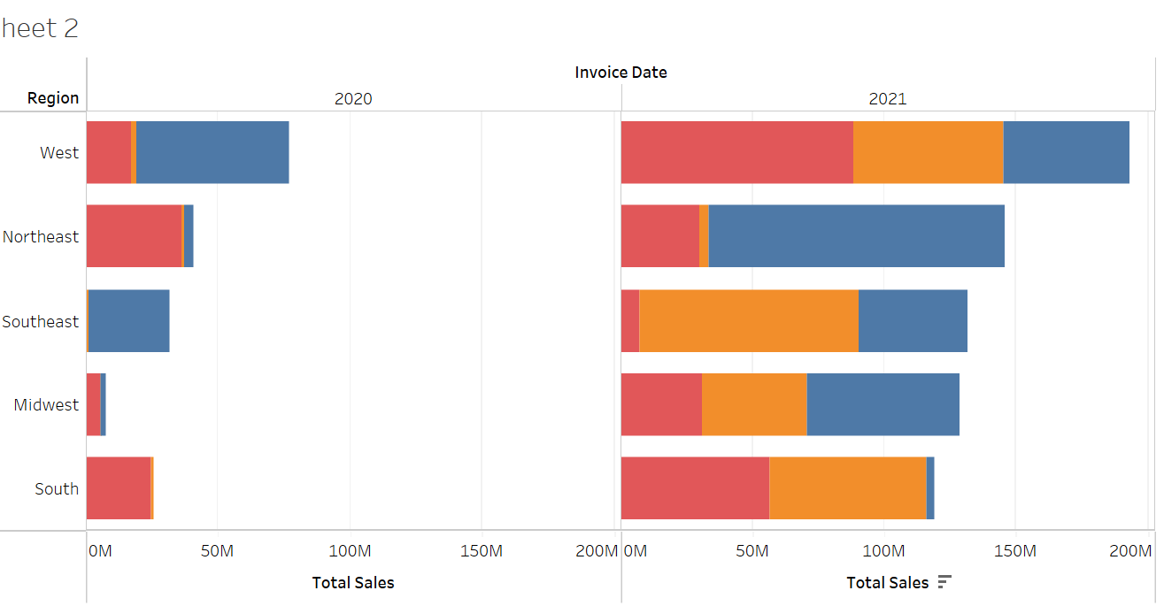
Exploratory Data Analysis - Bi-variate
Trend in Year-wise Sales (in $ Million) by Retailer and Channel
Trend in Year-wise Sales (in $ Million) by Region and Channel
Outlet
In-store
Online
New channel by retailers: Walmart, Kohl's and Amazon initiated in-store operations in 2021.
New Market Player: Amazon entered market in 2021
Overall Growth Rate: Foot Locker, Sports Direct and Kohl's were the fastest growing retailers, Walmart grew the slowest, over 2020-21
Instore Sales: Sports Direct and Footlocker, grew the fastest over 2021
Online Sales: All players boosted their online sales, led by Kohl's
Outlet sales: Walmart sale declined, and Sports direct grew fastest
Instore sales: Northeast and Midwest gained the most & Southeast was not growing much, West sale dropped.
Outlet Sales: Northeast sale dropped, Southeast started and West and South gained the most.
Online sales: Growth in all regions. Max gain by Southeast, South, West and Midwest
Key Highlights

Slide 13
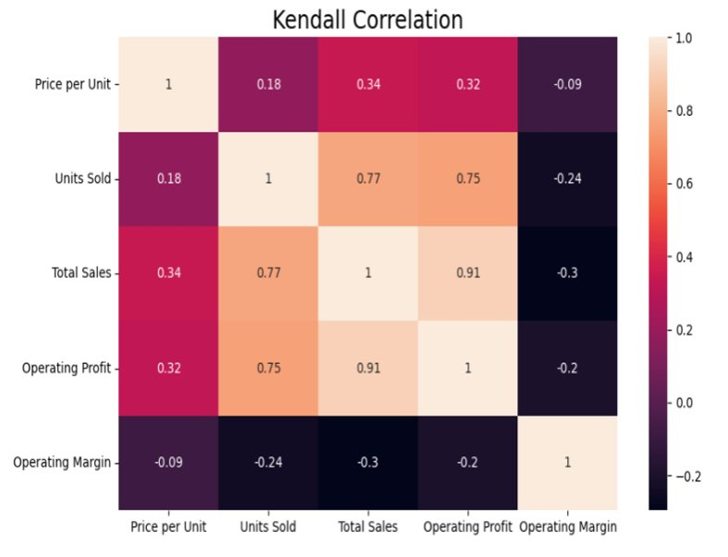
Correlation Plot
Key Highlights
Total Sales is strongly correlated with Operating Profit, units Sold and Price per unit​
Negative correlation is evident between Operating margin with Price per unit, Units Sold, Total Sales and Operating Profit​
Price per unit is positively correlated with Operating Profit, total sales and Units Sold​

Slide 14
Summary of EDA
Most retailers scaled up the business in 2021 . Significant Year-On-Year sales growth.
Opening up online platform for sales gained a high influx of overall sales
​Similar seasonality across product categories & channels with “Outlet sales” showing different behavior
Sales & profit have very strong correlation
Highest ASP (Average Selling Price) in In-Store followed by Outlet & Online
Physical store driving premium categories
Similar sales mix between men (55%) & women(45%) product categories
Basis correlation plot operating margin has negative relation with all other variables. Lower GM% generating more sales.

Slide 15

Model Development
- Clustering

Slide 16
CLUSTERING APPROACH
Segmentation/Clustering of the large retail dataset will enable Adidas to learn past market trends. This new clusters will help the brand learn more about retailers, regions and products and enable them to make tailer-made campaigns to reach its audience.
A data-driven predictive model will be applied to the dataset to identify potential clusters. Different unsupervised machine learning clustering techniques to be applied.
Use of different clustering machine learning techniques will enable us determine, the best model for the dataset and arrive at the best number of the clusters for the available heterogenous data.
Once we have extracted smaller homogeneous groups(clusters), business can focus on targeting activities towards this group.
As new data gets generated, this process should be continued with periodic updates to the data to improve the model and define new clusters

Slide 17
Clustering
Clustering, an unsupervised learning technique, is the process of arranging a group of objects in such a manner that the objects in the same group are more like each other than to the objects in any other group.
Clustering Algorithms
Applications of Clustering Algorithms
K-Means
K-Prototype Clustering
DBSCAN
Hierarchical Clustering
BIRCH
Mean Shift Algorithm
Gaussian Mixture Model
Retail Clustering
Customer Segmentation
Clinical Management
Image Segmentation
Pattern Recognition
Social network analysis

Slide 18
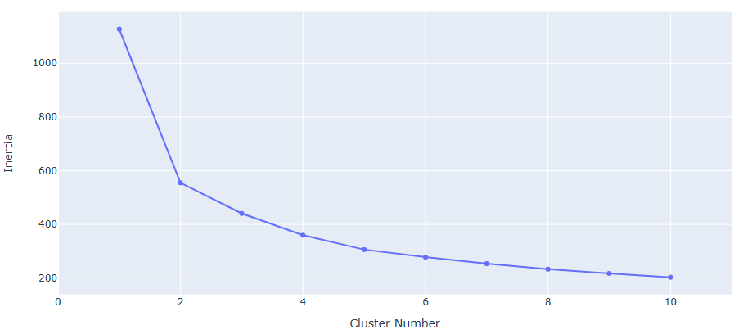
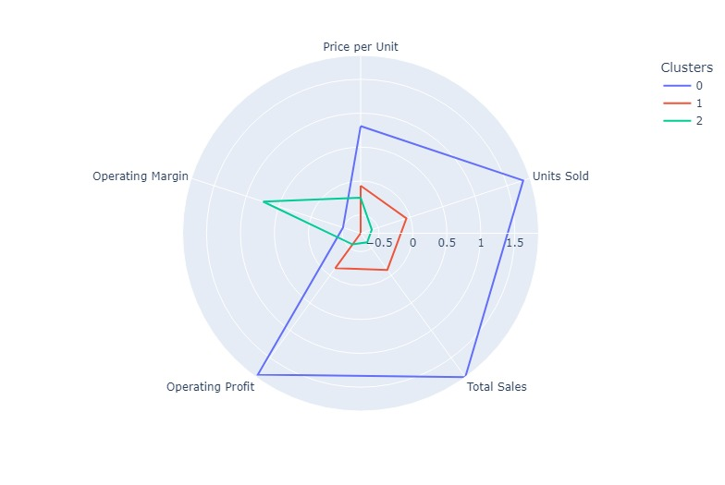
Clustering (K- Means Method)
K-Means performs the division of objects into clusters that share similarities and are dissimilar to the objects belonging to another cluster.
‘K’ in the name of the algorithm represents the number of groups/clusters we want to classify our items into.
Undertook Elbow approach – one of the most common techniques for figuring out the ideal number of groups (k) to divide the data into.
Selected number of clusters = 3
Evaluation metric considered - Silhouette Coefficient = 0.294
The clusters formed distinctly had the following features
Cluster 0 (blue): Low operating margin but the other features are trending high
Cluster 1 (red): Similar characteristics as cluster 0 but the averages for the features are significantly low
Cluster 2 (green): High operating margin whereas the other features are trending comparatively low

Slide 19
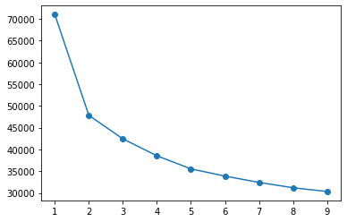

Clustering (K- Prototype Method)
K-Prototype can handle clustering algorithms with the mixed data types (numerical and categorical variables).
Its algorithm is an improvement of the K-Means and K-Mode clustering algorithm to handle clustering with the mixed data types.
Selected number of clusters = 3 from the elbow method
The clusters formed distinctly had the following features
Cluster 0 (blue): Low operating margin but the other features are trending high
Cluster 1 (red): Similar characteristics as cluster 0 but the averages for the features are significantly low
Cluster 2 (green): High operating margin whereas the other features are trending comparatively low

Slide 20
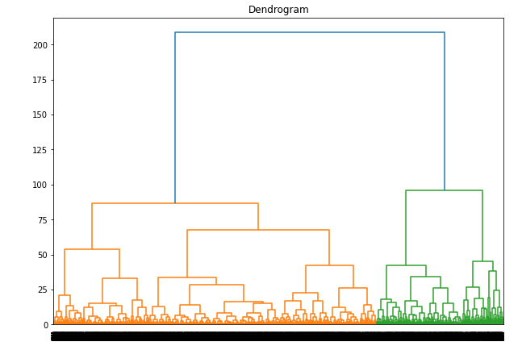
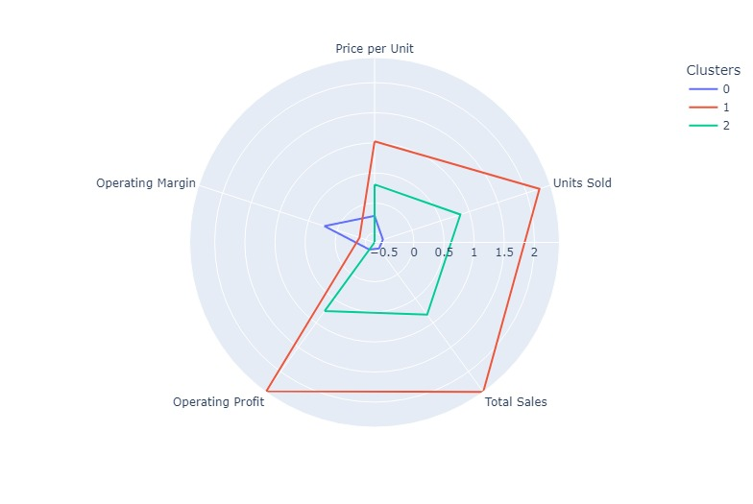
Clustering (Hierarchical Method)
Applied Agglomerative Clustering technique - initially each data point is considered as an individual cluster. At each iteration, the similar clusters merge with other clusters until one cluster or K clusters are formed.
This technique can be visualized using a Dendrogram - a tree-like diagram that records the sequences of merges or splits.
Selected number of clusters = 3
Evaluation metric considered - Silhouette Coefficient = 0.361
The clusters formed distinctly had the following features
Cluster 0 (blue): High operating margin whereas the other features are trending comparatively low
Cluster 1 (red): High operating margin whereas the other features are trending comparatively low
Cluster 2 (green): Similar characteristics as cluster 1 but the averages for the features are significantly low

Slide 21
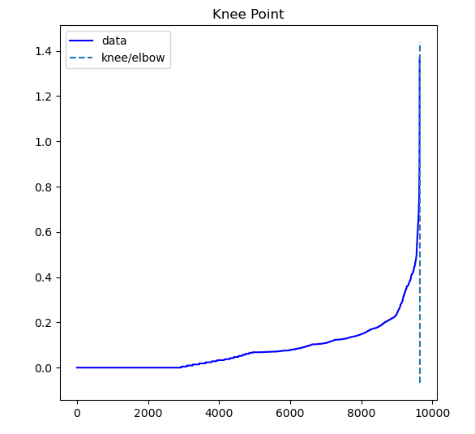
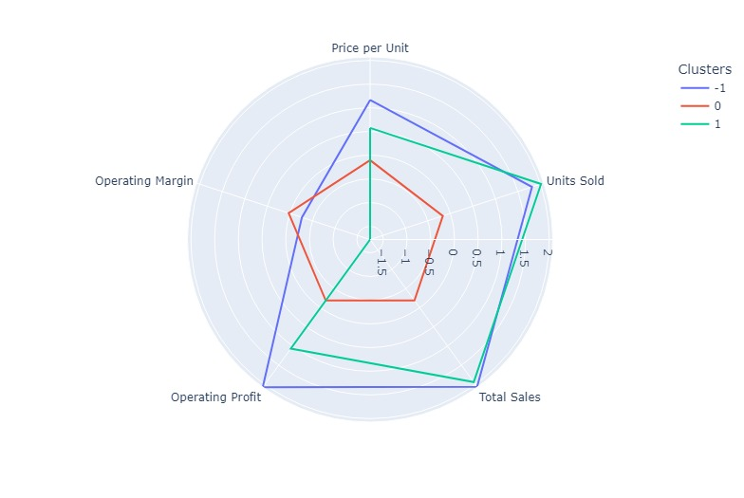
Clustering (DBSCAN)
DBSCAN is a density-based clustering algorithm - works on the assumption that clusters are dense regions in space separated by regions of lower density.
The key parameters:
Minimum samples (“MinPts”): the minimum number of points required to form a cluster.
ε (epsilon or “eps”): the maximum distance two points can be from one another while still belonging to the same cluster.
For optimal value calculated k-nearest neighbor (kNN) distances – got the knee at 1.28
With eps = 1.23 and minimum samples = 10, got 2 clusters with one as noise(-1,0). For attaining 3 clusters – eps = 0.55, minimum samples = 20
Evaluation metric considered - Silhouette Coefficient = 0.383
The clusters formed distinctly had the following features
Cluster -1 (blue): Low operating margin in comparison to the other features that are trending high
Cluster 0 (red): Highest operating margin and similar levels other features
Cluster 1 (green): Lowest operating margin, highest units sold with other features trending high
Notes:
In DBSCAN clustering, it groups ‘densely grouped’ data points into a single cluster. It can identify clusters in large spatial datasets by looking at the local density of the data points.
One key feature of DBSCAN clustering is that it is robust to outliers.
It also does not require the number of clusters to be told beforehand, unlike K-Means, where we have to specify the number of centroids.

Slide 22
Summary of Clustering Techniques Selected
K-Means
K-Prototype Clustering
Hierarchical
Clustering
DBSCAN

Slide 23

Inferences & Recommendations

Slide 24
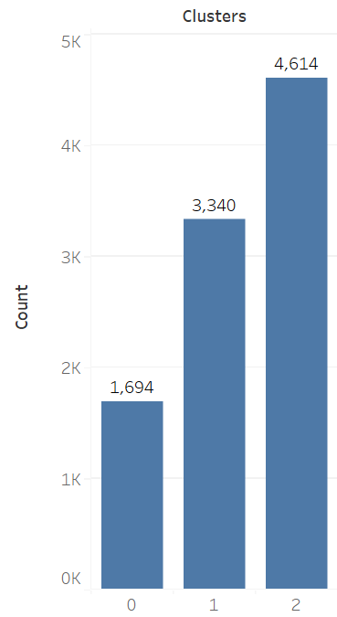
Understanding the Clusters
Clusters are fairly distributed with lowest counts in “0”
Cluster 0-2 following high to low trend for most KPIs except GM% which is other way around

Slide 25
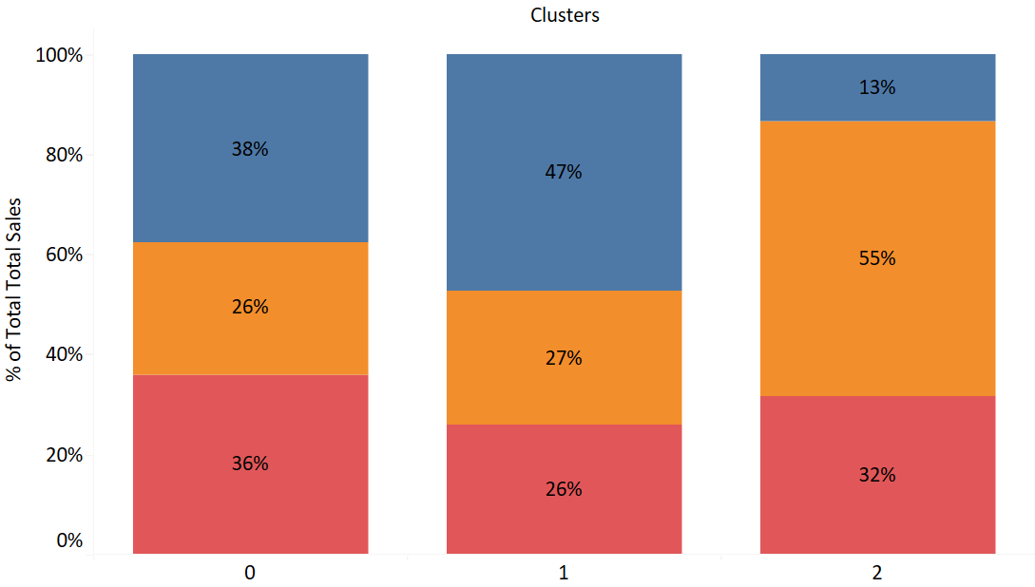
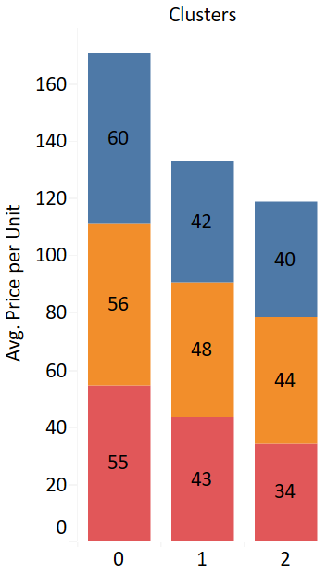
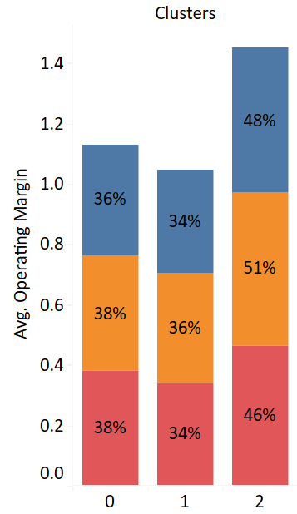
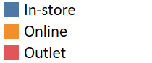
Cluster Profiling
Higher mix of Physical stores (In-store & Outlet) in cluster 0&1 , cluster 2 skewed towards online
Price per unit lower in “cluster 2” but GM% higher across channels & product categories

Slide 26
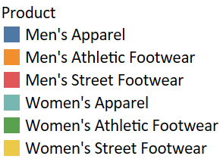
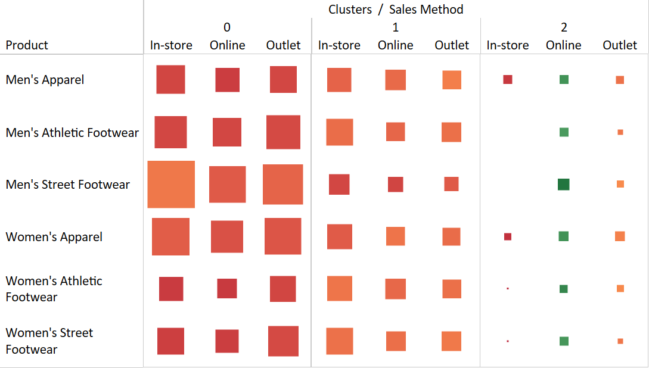
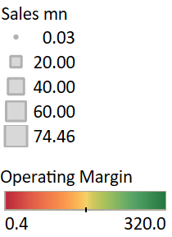
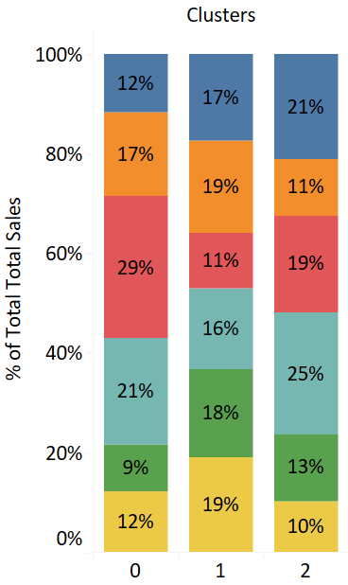
Cluster Profiling
Cluster 0 – Higher sales mix of Men’s street footwear
Cluster 1 – Fair mix of all product categories
Cluster 2 – Higher mix of women’s apparel
Low sales Footwear category footwear “In-Store”
Men’s footwear is completely missing in In-store

Slide 27
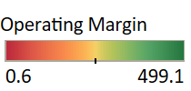
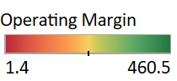
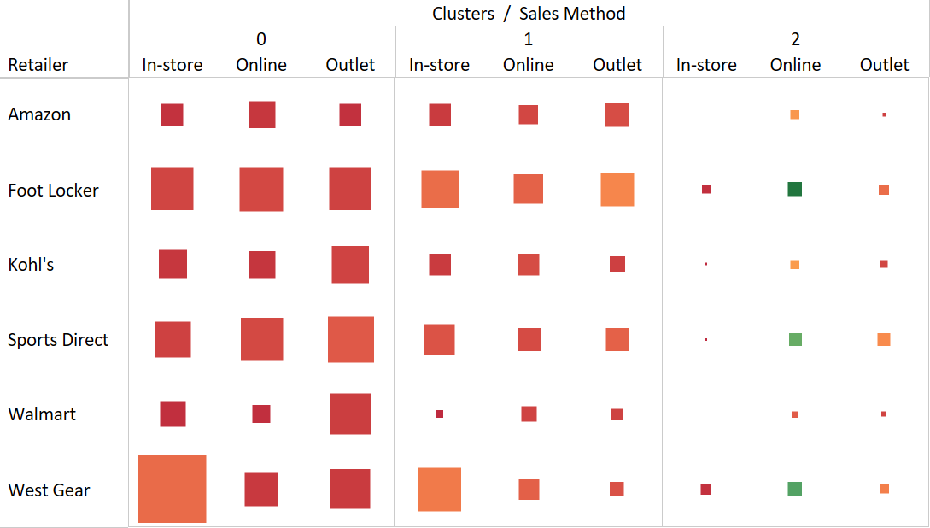
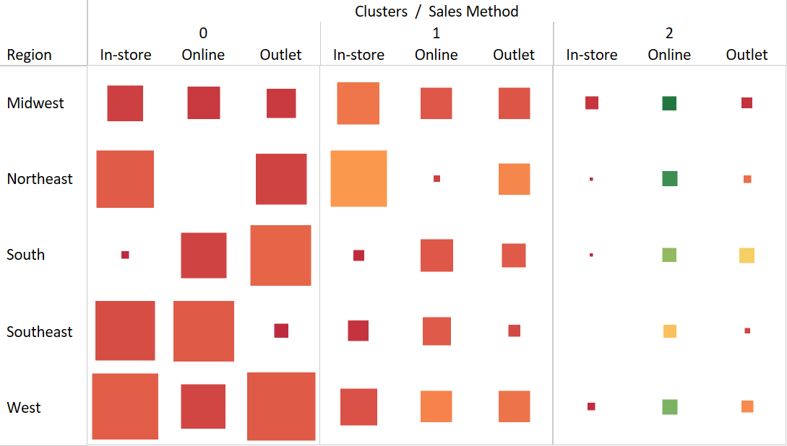
Cluster Profiling
Cluster 0 - Low In-store sales from South & no sales of northeast in online
- West Gear is dominant retailer (In-Store)
Cluster 1 - Footlocker has high contr. across channel
Cluster 2 - Walmart & Amazon missing for In-store channel
- No sales from South east region for In-store

Slide 28
Cluster Profiling - Summary
About Cluster Number : 0
Higher mix of Physical stores
Selling more of high value products
Major sales of Walmart stores in this cluster
Good mix across product categories
About Cluster Number : 1
Highest mix of Physical stores
Selling more of high value products
Equal mix of men & women categories
About Cluster Number : 2
Highest mix of Online channel
GM% highest , across categories & channel
Low mix of footwear categories

Slide 29
Recommendations
Cluster Number : 0
Target premium/limited products
Ideal customer for “walmart”
Explore online channel for “NorthEast” region
Cluster Number : 1
Explore online channel with focus on lower price & higher margin products
Cluster Number : 2
Continue to focus on “online” in line with changing consumer behavior
Footwear category an “opportunity”
Explore possibility of entering physical stores especially “South East”

Slide 30
Thank You

